Slide 1
The Rise of Open Source Software
By
Name: Muhammad Saad
Reg. No: 21PWCSE1997
Section: B

Slide 2
Open Source and Proprietary Softwares
Open source software have their source code public to everyone. Open source software are licenced under different types of licences like GPL, MIT Licence, Apache Licence, BSD Licence etc.
Proprietary software are those software that are legally owned by a company as their property. They publish their software as precompiled to the people.

Slide 3
History
In 1960’s and 1970’s software were free and companies mainly focused on hardware.
Then large buisnesses started to see software as a potential source of income.
In 1981 MSDos was released and this showed the whole world how much profiting can a software can be.
Two years later in 1983 Richard Stallman tried to develop an open source operating called GNU but this OS was not functioning properly.
In about 1991 Linus Torvalds completed this project by making a kernel for it . He called this Linux.

Slide 4
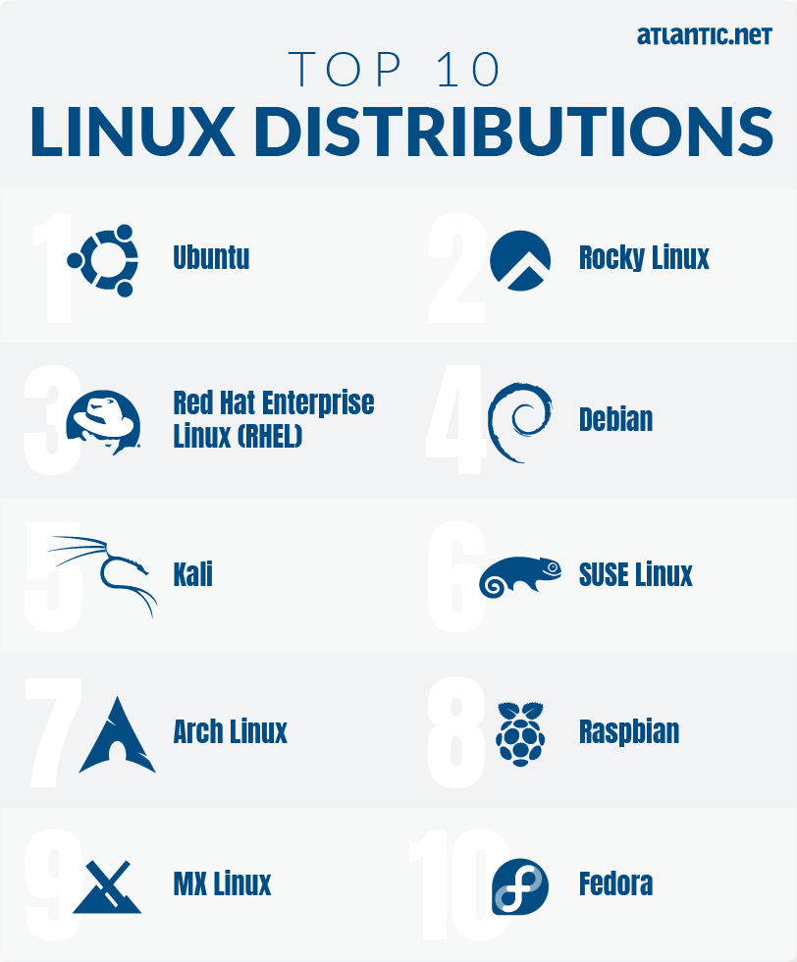
Linux
Linux was a free and open source alternative to Windows and MacOS.
Other developers also modified the Linux project, among which Debian and Arch are the most notable ones.
These modified versions of Linux are called Linux Distributions.
In 2000’s this OS was mainly popular in server computers and other corporations.
Till today Linux has more than hundred of distributions. Most of which are being maintained by volunteers and not by some corporations.

Slide 5
Advantages of a project being open source
Open source projects are mostly community driven, they are made by community and they are made the way community wanted the software to.
They are almost free of any bugs or flaws and if there are any in the code, anyone can fix the bugs and request the developer to include their code in the project.
There are about over 40 million user on GitHub who are modifying other projects, developing their own and studying already published codes. It is said that about 4000 lines of code is added everyday to Linux by the volunteers.
Open source projects can also help the students learn how software work and how they are made.

Slide 6
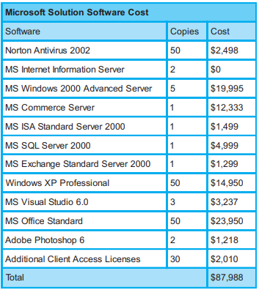
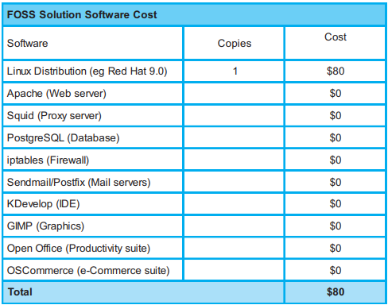
Linux and Windows Price comparison at a enterprise level

Slide 7
Disadvantages
One of the biggest disadvantage of open source software is that it is free which for developers is a deal breaker, that is why there are so many projects abandoned.
Some projects on GitHub are being used by big companies but developers get nothing in return.

Slide 8
Monetizing an open source project
Open source developers make money by donations from the consumers of the project.
But there are some people who built whole companies around Linux and other open source projects. One example of this is Red Hat Linux Enterprises a billion dollar company.

Slide 9
Where are open source projects today
Open source community still exist and most probably will exist in the future.
Although there are very few software that are open source and are used daily by normal people.
Still in startups and other companies are using these projects heavily.

